Slide 1


PUSL2024
Software Engineering 02
Plymouth Batch 11
Pramudya Thilakaratne pramudya.h@nsbm.ac.lk
HOD / Lecturer
Department of Computer & Data Science
Faculty of Computing
NSBM Green University
Lecture 01

Slide 2
Computing Group Project
Module Overview
Module Code – PUSL2024
No of Credits – 20 Credits
Delivery Plan – Semester I
Lectures on Thursday 2pm-5pm
Degree Cohorts - Software Engineering / Computer Networks / Computer Security/ Technology Management

Slide 3
Java Programming
Java is a high- level, class based, object-oriented programming language.
Java is used to develop desktop, mobile and web applications, big data processing, embedded systems etc.
Oracle is the company which owned Java language.

Slide 4
What is JVM
JVM (Java Virtual Machine) is an abstract machine that enables your computer to run a java program.
When you run the Java program, Java compiler first compiles your java code to bytecode. Then, the JVM translate bytecode into native machine code.

Slide 5

What is JVM

Slide 6
What is JVM
Java is a platform- independent language. It’s because when you write java code, it’s ultimately written for JVM but not your physical machine.
Since JVM executed the java bytecode which is platform independent, java is platform independent.

Slide 7
What is JRE
JRE (Java Runtime Environment) is a software package that provides java class libraries, JVM and other components that are required to run Java applications.

Slide 8
What is JDK
JDK (Java Development Kit) is a software development kit required to develop applications in Java.
When you download JDK, JRE is also downloaded with it.
JDK also contains a number of development tools(compilers, JavaDoc, Java Debugger etc)

Slide 9
Java Variables
A variable is a location in memory (storage area) to hold data.
To indicate the storage area, each variable should give a unique name (identifier).

Slide 10
Java Data Types
As the name suggests, data types specify the type of data that can be stored inside variables.
Java is a statically-typed language which means that all variables must be declared before they can be used.
int, String, double, bool etc.

Slide 11
Java Operators
Operators are symbols that perform operations on variables and values.
Arithmetic Operators
Assignment Operators
Relational Operators
Logical Operators

Slide 12
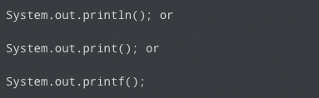

Java Basic Input and Outputs
Java Output
Example

Slide 13
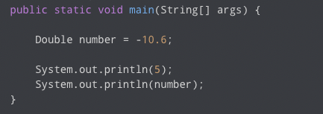
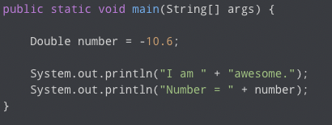
Java Basic Input and Outputs
Java Printing Variables
Java Printing Variables with Text

Slide 14

Java Basic Input and Outputs
Java Input
Java provides different ways to get input from the user.
In order to get user inputs, Scanner class will use. Package called java.util.Scanner should import first.

Slide 15
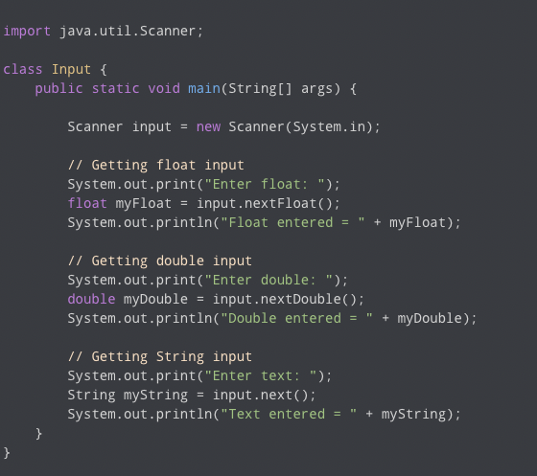
Java Basic Input and Outputs
Java Input Example

Slide 16
Tasks
Task 01
Create a Java application to get users’ name and display a greeting message.
Task 02
Create a Java application to get two numerical inputs from user and display the multiplication value from the app.
Task 03
Create a Java application to check whether user input number is a odd or even number

Slide 17

Break Time Resume at – 11.15am

